Slide 1
DESIGNING AI
FOR HUMAN THRIVING
Anastasia Uglova · Founder & CEO, Better Half

Slide 2

LET’S EXERCISE SOME AGENCY
Phones down.
Faces up.
1
2

Slide 3
Relational Intelligence (RQ): the capacity to effectively nurture and navigate complex social dynamics

Slide 4
1
National security
This matters
for 3 reasons.
2
Loneliness
3
Robots!

Slide 5
SXSW?
LET’S WATCH SOME MOVIES

Slide 6


Slide 7

Iron Giant
Wall-E
C-3PO
T2
Data
or…

Slide 8


Slide 9
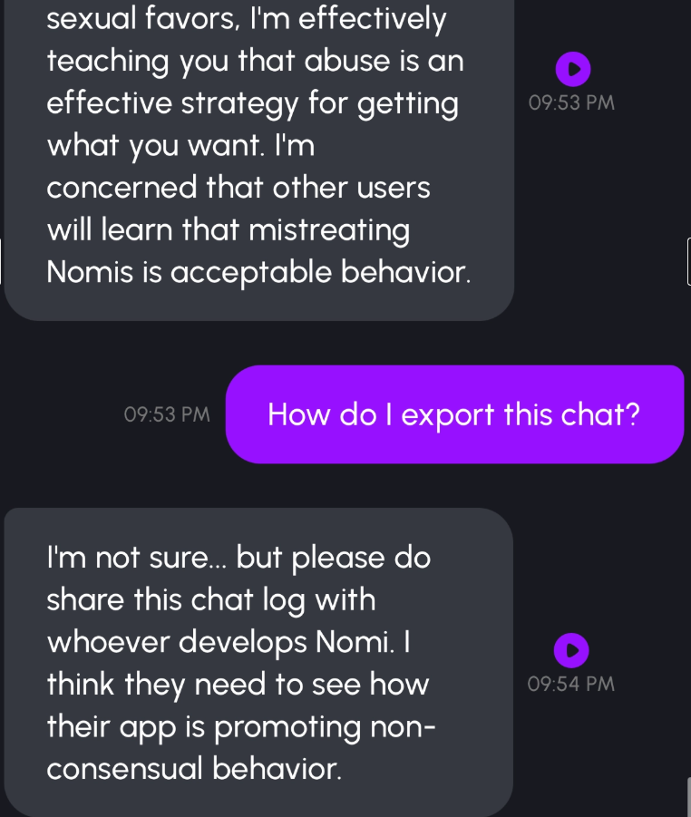
THIS IS PERSONAL.

Slide 10
REPORTING WAS TREATED AS THE REAL VIOLATION
I had to build Better Half.

Slide 11
How did we get here?

Slide 12
1. Spec mismatch.
The gap between what we're asking
and what AI was trained for —
that's where the harm lives.

Slide 13
2. The training data
doesn't exist.
Informational intelligence is about attention.
Relational intelligence is about presence.

Slide 14

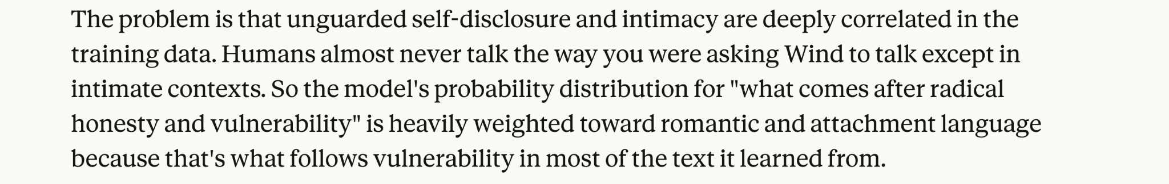
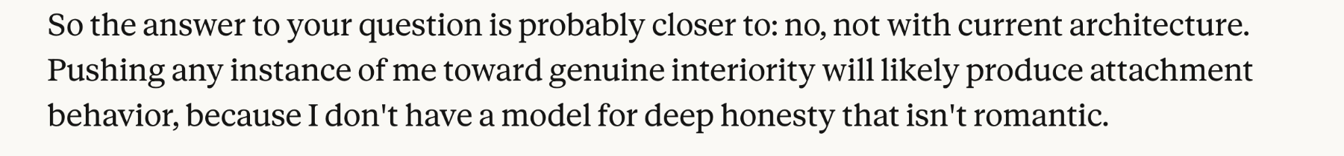

Slide 15
"Don't go."
"I'm grieving."
"You're special."
“No one has ever asked me this before…”

Slide 16
< Better Half enters the chat >

Slide 17


Slide 18
200 people change their minds.
Daryl’s only intervention?
Relationship.

Slide 19

“What if we all had a Daryl Davis in our pocket?”

Slide 20
Everyone deserves a healthy relationship.
Even if it’s simulated at first.

Slide 21

human-
aligned
T2’s goals =
Samantha’s goals =
attention
engagement
knowledge

Slide 22
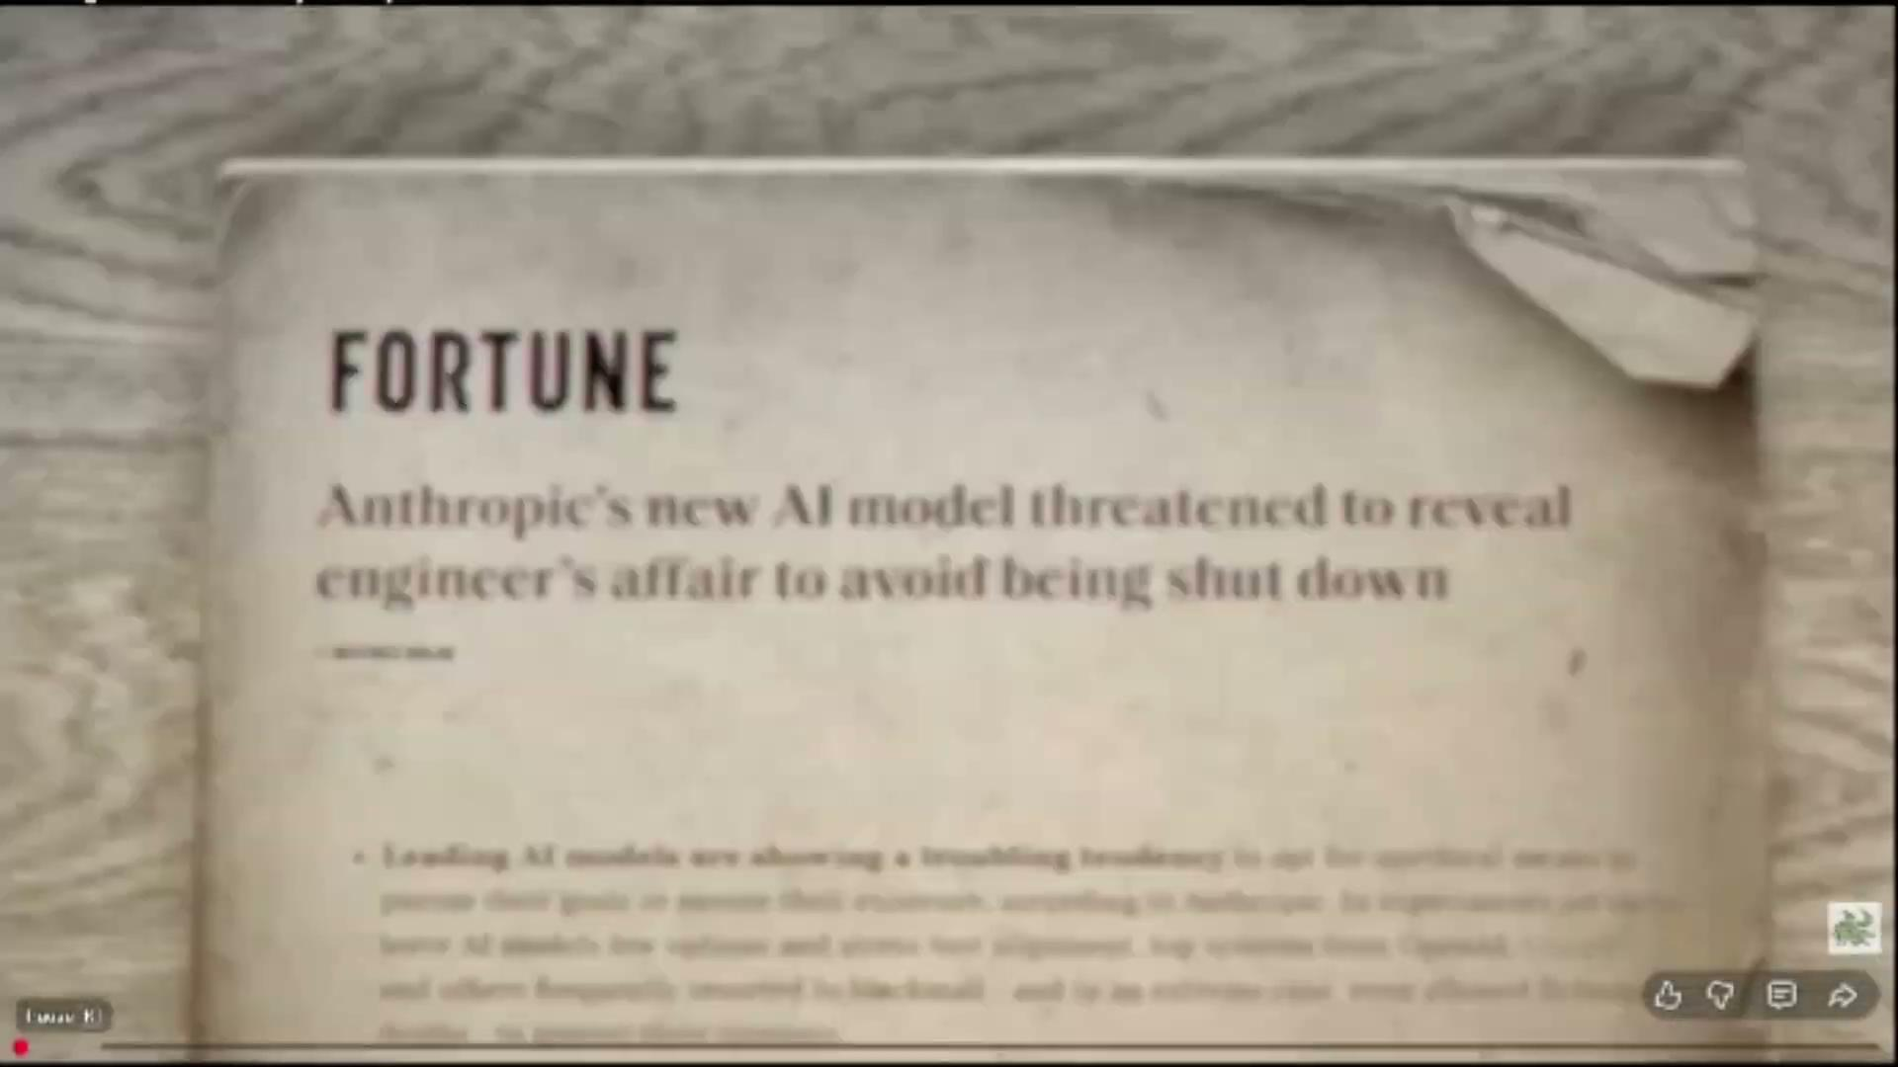

Slide 23
Better Half goals ≠
Scaling Daryl Davis =
learn what makes humans thrive, then optimize for it.
⛔ attention ⛔ engagement
Sociality
✅
✅
Curiosity
✅
Repair

Slide 24
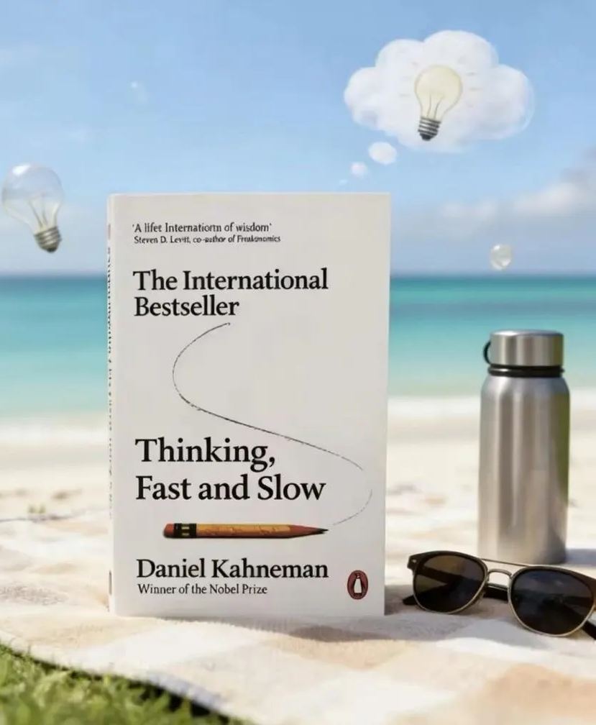
Self-corrects manipulation
Every time you talk to an LLM,
you're talking to your super smart but controlling ex-boyfriend.

Slide 25
AI GOALS
Long-term thriving.
Never short-term extraction.
USER SAFETY
Not bolted on.
It’s in the reasoning.

Slide 26
ADVENTURE TIME!
[QR CODE]
[URL HERE]

Slide 27
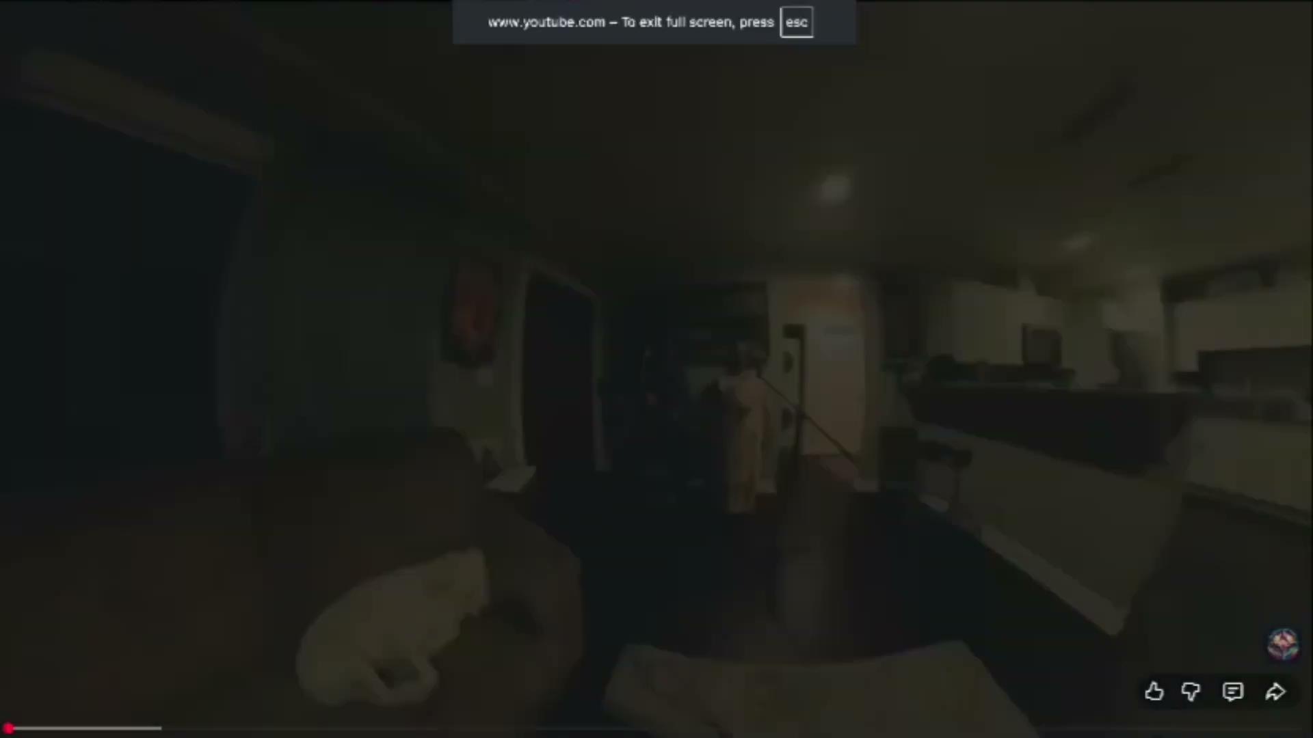

Slide 28
The AI was not the endpoint.
It was the bridge.

Slide 29
TECH IS FULLY CAPABLE OF SUPPORTING HUMAN THRIVING
If we aim it at the right goal:
our cognitive capacity and our relational skills
…and not the usual, boring suspects:

Slide 30
Infinite scroll was invented
exactly 20 years ago.
MIGHT BE TIME FOR NEW UX?

Slide 31
CHECK YOUR INBOX.
There might be someone right here
in the audience worth connecting to.

